Slide 1


“How long will this steroid injection last for?” An exploratory analysis of treatment response using daily symptom data collected via smartphone app
Dr Mariam Al-Attar
ST5 Rheumatology Registrar / Clinical Research Fellow Royal Bolton Hospital / Division of Informatics, Imaging and Data Science, UoM
Supervisors: Prof Will Dixon & Dr Sabine van der Veer
Notes:
My name’s Mariam, and today I’m presenting a novel approach to assessing treatment response using daily symptoms
I’ll start with a simple question, which you can answer in your head.

Slide 2
How are you doing today?
Notes:
How are you doing today?
Having fun (hopefully). You might be tired, or hungry.
This question shouldn’t be difficult to answer.

Slide 3
How have you been over the last 6 months?
Notes:
My next question then, is : How have you been over the last six months?
This might be harder to answer
There have likely been ups and downs – what will you remember?
And how do you summarise 6 months of information?

Slide 4




Recalling and summarising events over time is a challenge we regularly pose to patients with long-term conditions
“How long did the steroid injection last for?”
8 weeks
0 months
6 months
“Erm… maybe just a couple of weeks?”
Notes:
Recalling and summarising events over time is a challenge we regularly pose to patients with long-term conditions
Now, imagine you administer a treatment, like a steroid injection, and let’s say it works for 8 weeks
6 months later you ask them – how long did it last for?
Their answer is not likely to be accurate

Slide 5
Recall bias leads to poor understanding of treatment response
This impacts the care of people living with LTCs by influencing future treatment decisions
Notes:
Recall bias leads to poor understanding of treatment response, impacting clinical care for people with LTCs by influencing future treatment decisions

Slide 6


New opportunities for understanding treatment response: Patient-Generated Health Data (PGHD)
Notes:
Smartphones present new opportunities to collect frequent patient-generated health data in the period following an intervention, through which we could gain accurate, patient-centred insights into treatment response

Slide 7

This study aimed to:
1. Demonstrate proof-of-concept for a novel way of evaluating treatment response in long-term conditions
2. Demonstrate the value of combining smartphone data with NHS EHR data for population health research
Notes:
This study aimed to demonstrate proof-of-concept for the use of daily symptom data, combined with medication data, to analyse response

Slide 8



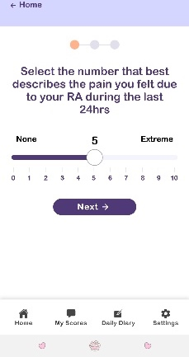


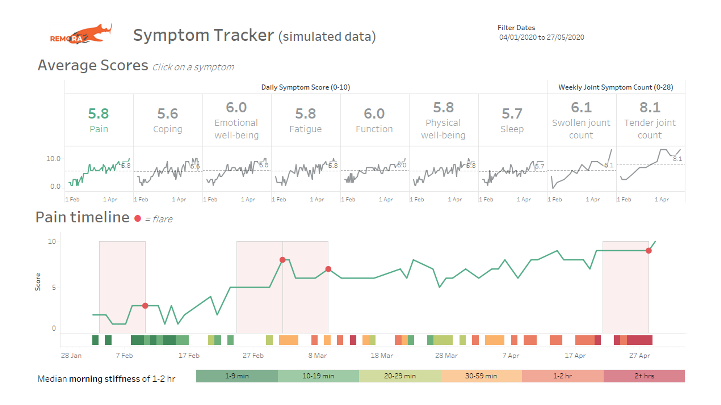

Study context: REMORA
NHS
NHS Login
Secondary data analysis (R1.5)
Daily smartphone symptom tracking (patient-reported)
Medication data extracted from EHR (clinician-reported)
Community
Tracked symptom data
Hospital
University
Patient-reported data for clinical use
Clinician-reported data for research
REMORA dashboard
Data deidentified for research
Data available for review
during consultations
Notes:
We used data from the REMORA trial, a prospective study where patients with rheumatoid arthritis used a smartphone-app to track daily symptom data, which was deidentified for research, but also pulled into their NHS records.

Slide 9
Response: Yes
Response end time
Pre-injection score: 7
Response duration: 54 days
Average pain score improvement: 4.44
Average pain score during response: 2.56
Treatment response definitions:
Pre-injection pain-score | Mean pain-score using all pain-scores available in the 10 days preceding steroid injection
Response | (Yes/No): Pain-score lower than pre-injection pain-score on the 1st day tracked following steroid injection
Response end time | For responders, first date following injection with pain-score greater than pre-injection pain-score
Response duration | Number of days between the response start time (day 1 post injection) and response end time
Average pain-score during response | Mean pain-score during response duration
Average pain-score improvement | Difference between pre-injection pain-score and average pain-score during response
Notes:
We created treatment response definitions based on changes from baseline pre-injection pain scores
Here, the red line indicates the injection, after which, the pain score drops, indicating response, which was maintained for 54 days
We applied these definitions to a series of 9 cases

Slide 10


Results
Pre-injection pain scores: 3.3-9.3 (mean 5.8)
7 responders 2 non-responders
Of the responders:
Response duration 1-54 days (median 9)
Pain score improvement 0.1-5.3 (mean 3.3)
Injection number (patient number) | Age (years) | Sex | Disease-modifying medications during period of analysis | Intramuscular steroid dose (mg) | Response? | Response duration (days) | Pre-injection pain-score | Average pain-score response | Nadir pain-score response | Average pain-score improvement | Maximum pain-score improvement
1 (1) | 30 | Male | MTX | 120 | Yes | 9 | 7.33 | 4.00 | 3.00 | 3.33 | 4.33
2 (1) | 30 | Male | MTX, SSZ | 120 | Yes | 10 | 8.00 | 2.67 | 1.00 | 5.33 | 7.00
3 (1) | 30 | Male | - | 180 | Yes | 9 | 5.40 | 1.80 | 1.00 | 3.60 | 4.40
4 (2) | 53 | Female | MTX, HCQ | 120 | Yes | 7 | 3.33 | 3.00 | 3.00 | 0.14 | 0.14
5 (3) | 52 | Male | MTX | 160 | Yes | 1 | 5.75 | 4.00 | 4.00 | 1.67 | 1.67
6 (3) | 52 | Male | SSZ | 160 | No | - | 9.29 | - | - | - | -
7 (4) | 53 | Male | MTX | 120 | Yes | 41 | 4.56 | 2.21 | 1.00 | 2.35 | 3.56
8 (5) | 65 | Male | SSZ, HCQ | 120 | Yes | 54 | 7.00 | 2.56 | 1.00 | 4.44 | 6.00
9 (6) | 40 | Female | MTX, SSZ | 120 | No | - | 5.56 | - | - | - | -
Range (Median) | 30-65 (52) | - | - | - | - | 1-54 (9) | 3.33-9.29 (5.75) | 1.80-4.00 (2.67) | 1.00-4.00 (1) | 0.14-5.33 (3.33) | 0.14-7.00 (4.33)
Al-Attar et al 2024 (JMIR Formative Research)
Notes:
These were our results
To summarise
7/9 patients responded
With a duration between 1-54 days, and average pain score improvement of 3.3

Slide 11
Discussion
This study:
Demonstrates proof-of-concept for a promising new method
Provides previously unseen insights into steroid injection treatment response
From this, we learned lessons to shape future, population analyses
e.g. treatment response trajectory prediction using daily PGHD
Importantly, for our patients, this method gives us a better understanding of patient perspective in treatment response, surfacing information which could otherwise be missed in usual consultations:
Patient quote (PPIE Meeting): “It was a constant battle with different rheumatologists who were really keen to say that I was in remission…but I actually felt really bad."
Notes:
This study demonstrates proof-of-concept for a promising methodology, and provides previously unseen, detailed insights into steroid injection response
We’ve learnt lessons form this to shape future, large-scale work, but
Importantly, this method gives a better understanding of patient perspective in treatment response, surfacing information which could otherwise be missed, so we can avoid what was described by a patient as “a constant battle with different rheumatologists who were really keen to say that I was in remission…but I actually felt really bad."

Slide 12
Key message
Combining daily PGHD collected via smartphone-app with treatment data from NHS electronic records to understand treatment response has transformative potential for people living with long-term conditions
Notes:
In summary
Combining daily PGHD collected via smartphone with treatment data from NHS electronic records to understand treatment response has transformative potential for people living with long-term conditions

